Slide 1
Diodes - 2

Slide 2
Outline
Diode Models and IV Characteristics: Review
Diode Logic OR operation
Diode Logic AND operation

Slide 3
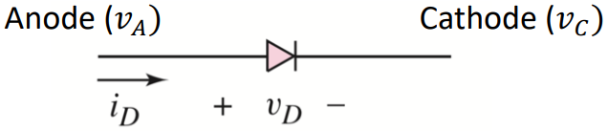
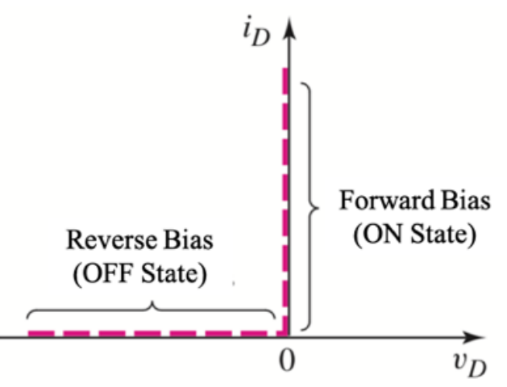
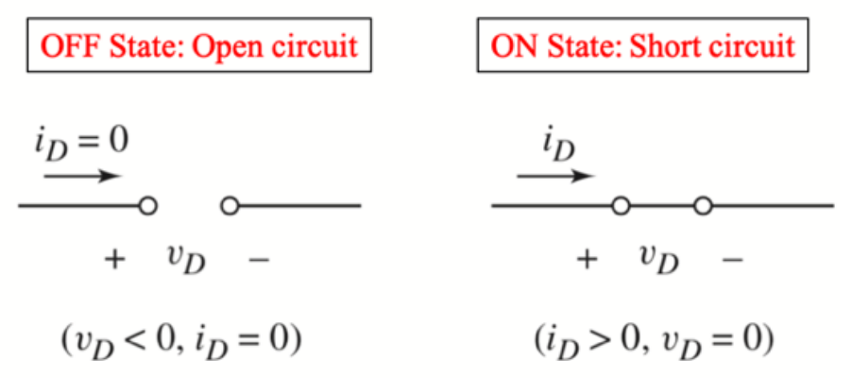
Review: Ideal Diode Model
From Microelectronics: Circuit Analysis and Design by Donald A. Neamen: Chapter 2. 4th edition. Published by the McGraw-Hill Companies, Inc. Used for educational purposes only.

Slide 4
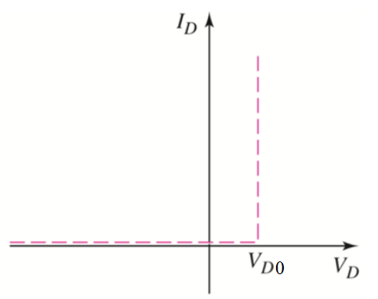
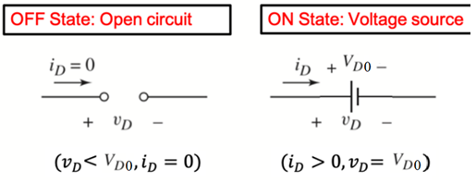
Modeling the real diode
1. Ideal diode model
2. Constant voltage drop (CVD) model
3. CVD+R model

Slide 5
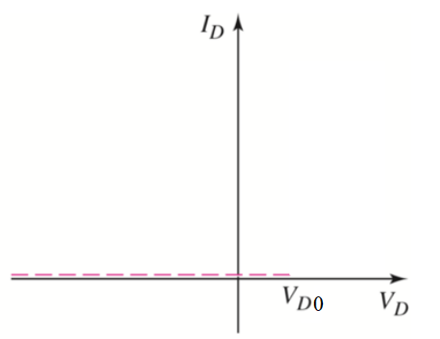
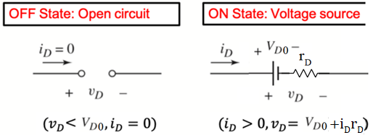
Modeling the real diode
1. Ideal diode model
2. Constant voltage drop (CVD) model
3. CVD+R model
1/slope = R

Slide 6
Digital Representation
Binary → Two states (0/False, 1/True)
Binary variables in circuit, need to use two states of device/parameters
Voltage |  | Current |  |  |  | State
5V → | 1 |  | 2mA | → | 1 | ON → | 1
0V → | 0 |  | 3mA | → | 0 | OFF → | 0
0V → 1 3.3V → 0 |  |  |  |  |  | Low resistance High resistance
Diode
Memristor
→ 1
→ 0

Slide 7
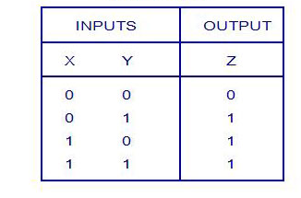
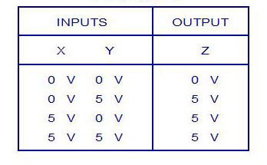
Logical Operations with Diode (OR)
Logic Truth Table
Voltage Truth Table
Low/False High/True
Logic Levels: 0 1
Corresponding voltage levels: 0V 5V

Slide 8
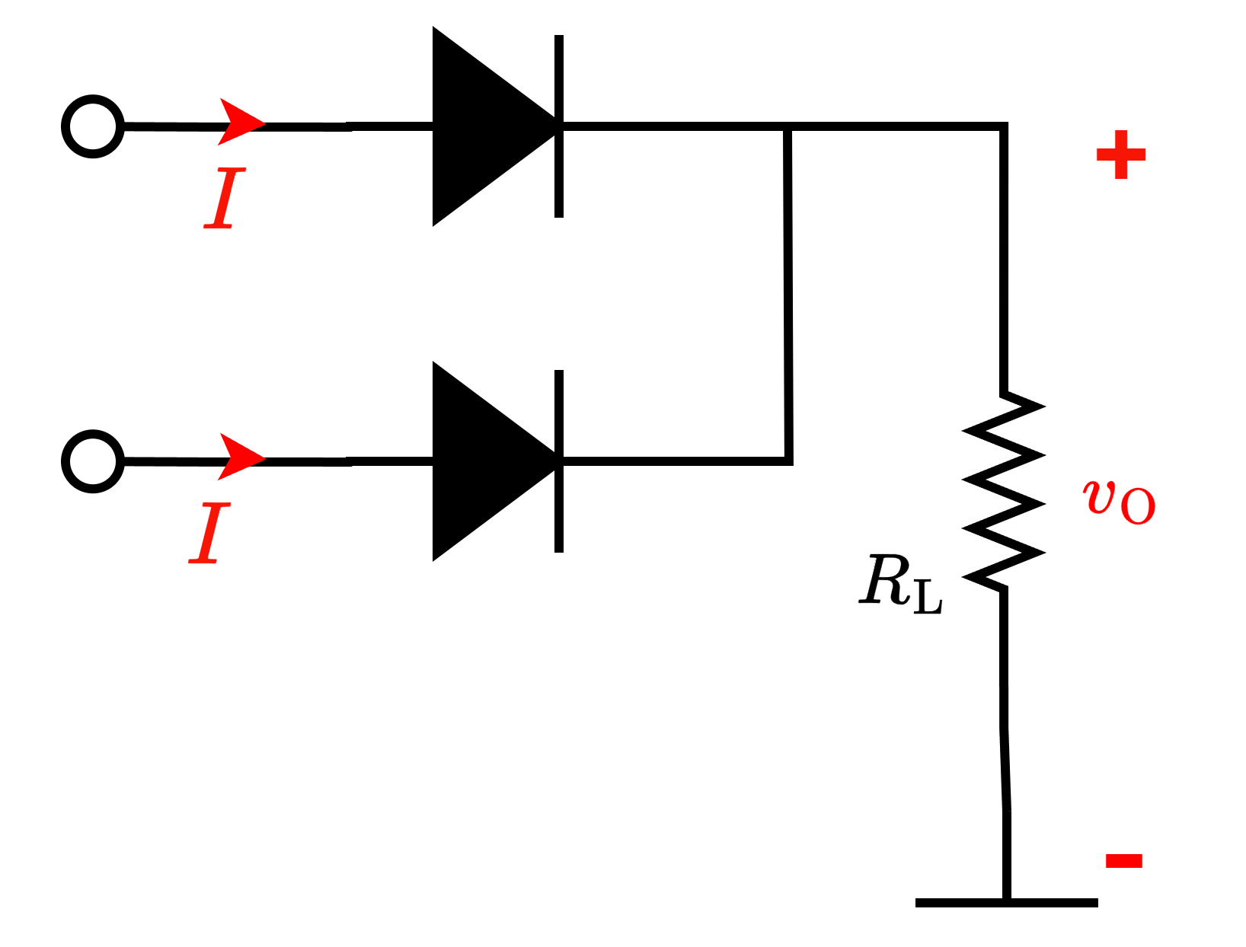

Logical Operations with Diode (OR)
Voltage Truth Table
X
Y
=Z
PULL DOWN NETWORK
When all inputs are completely disconnected, $v_{O}$ is pulled down to GND
Degrades the HIGHEST output voltage

Slide 9
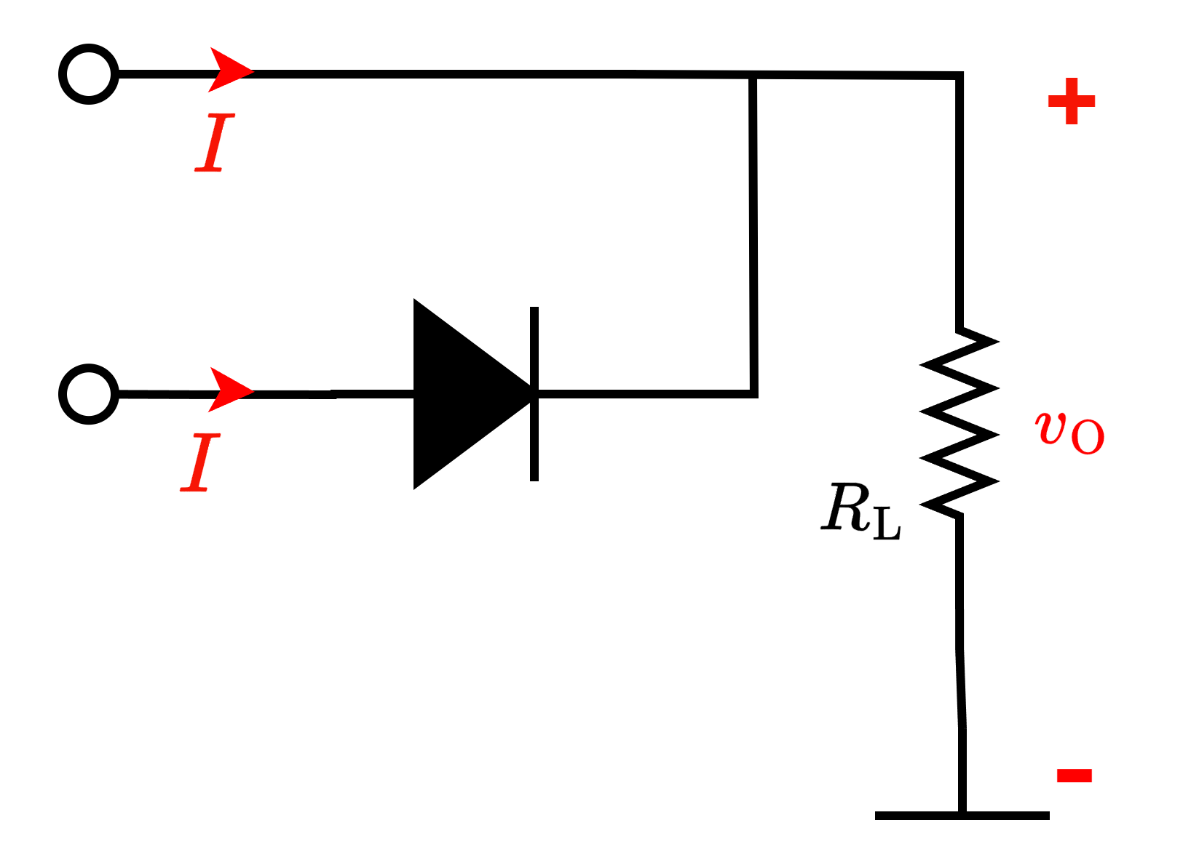
Logical Operations with Diode (OR)
Ideal diode
5 V
5 V
5 V
0 V
0 V
Z = 5 V

Slide 10
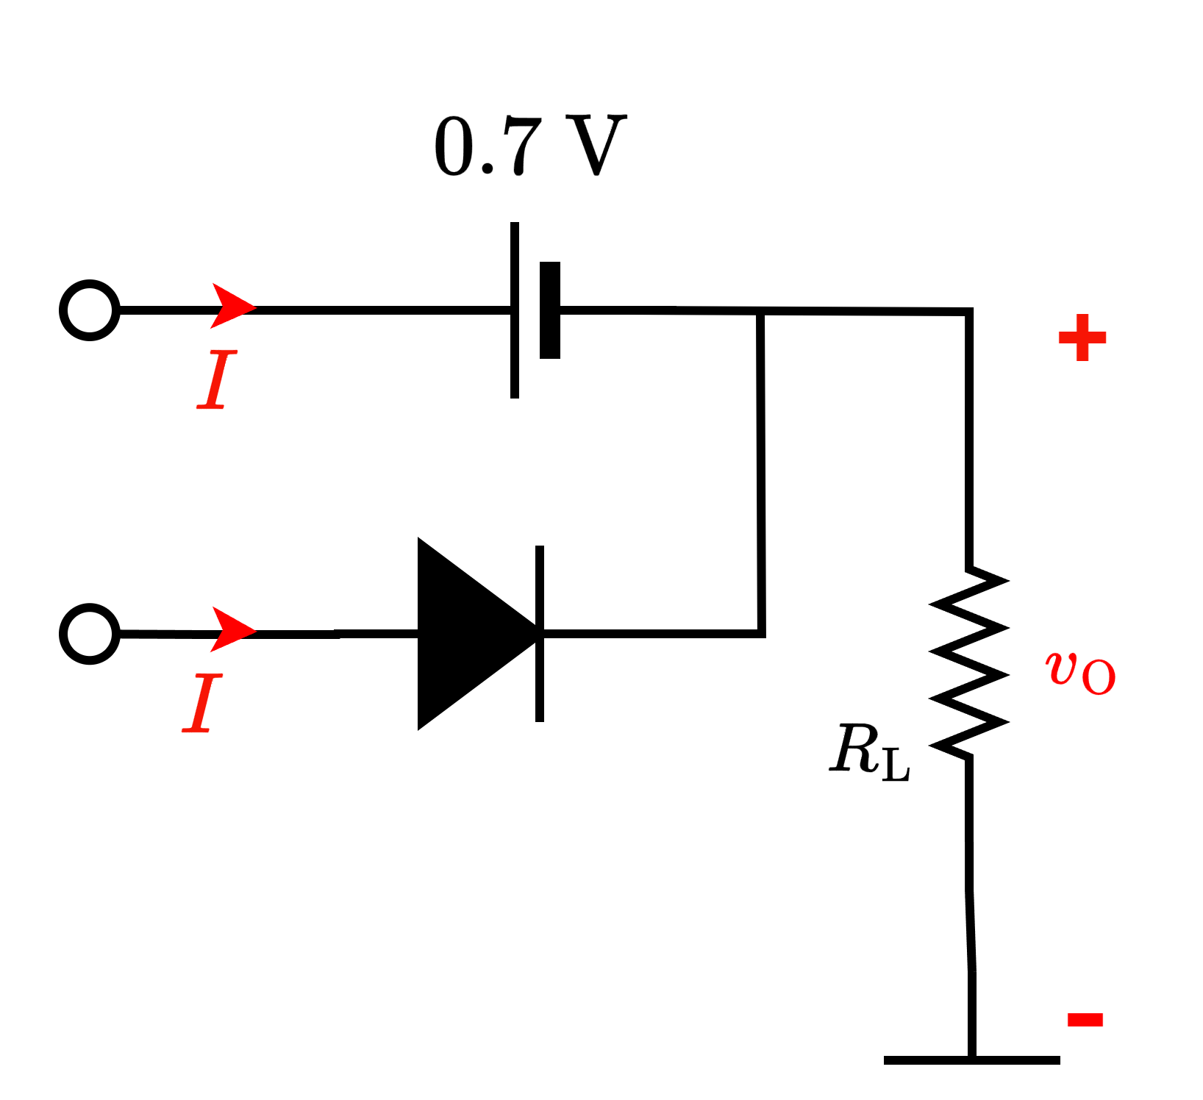
Logical Operations with Diode (OR)
CVD diode
4.3 V
5 V
5 V
0 V
0 V
Z = 4.3 V
Degraded 5 V

Slide 11


Logical Operations with Diode (OR)
Ideal diode
0 V
$$I=0$$
0 V
0 V
0 V
0 V
$$I=0$$
Z = 0 V

Slide 12
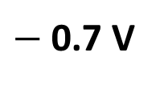
Logical Operations with Diode (OR)
CVD diode
$−$ 0.7 V
0 V
0 V
0 V
0 V
Z = 0 V

Slide 13
Logical Operations with Diode (OR)
Ideal diode
5 V
5 V
5 V
5 V
5 V
Z = 5 V

Slide 14
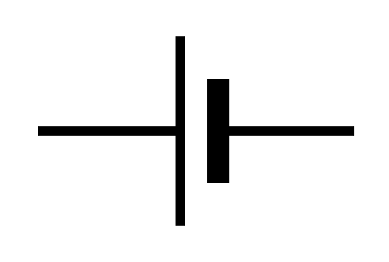
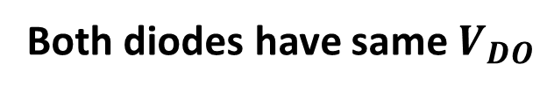
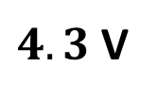
Logical Operations with Diode (OR)
CVD diode
$4.3$V
5 V
5 V
5 V
5 V
0.7 V
Z = 4.3 V
Degraded 5 V
Both diodes have same $V_{DO}$

Slide 15
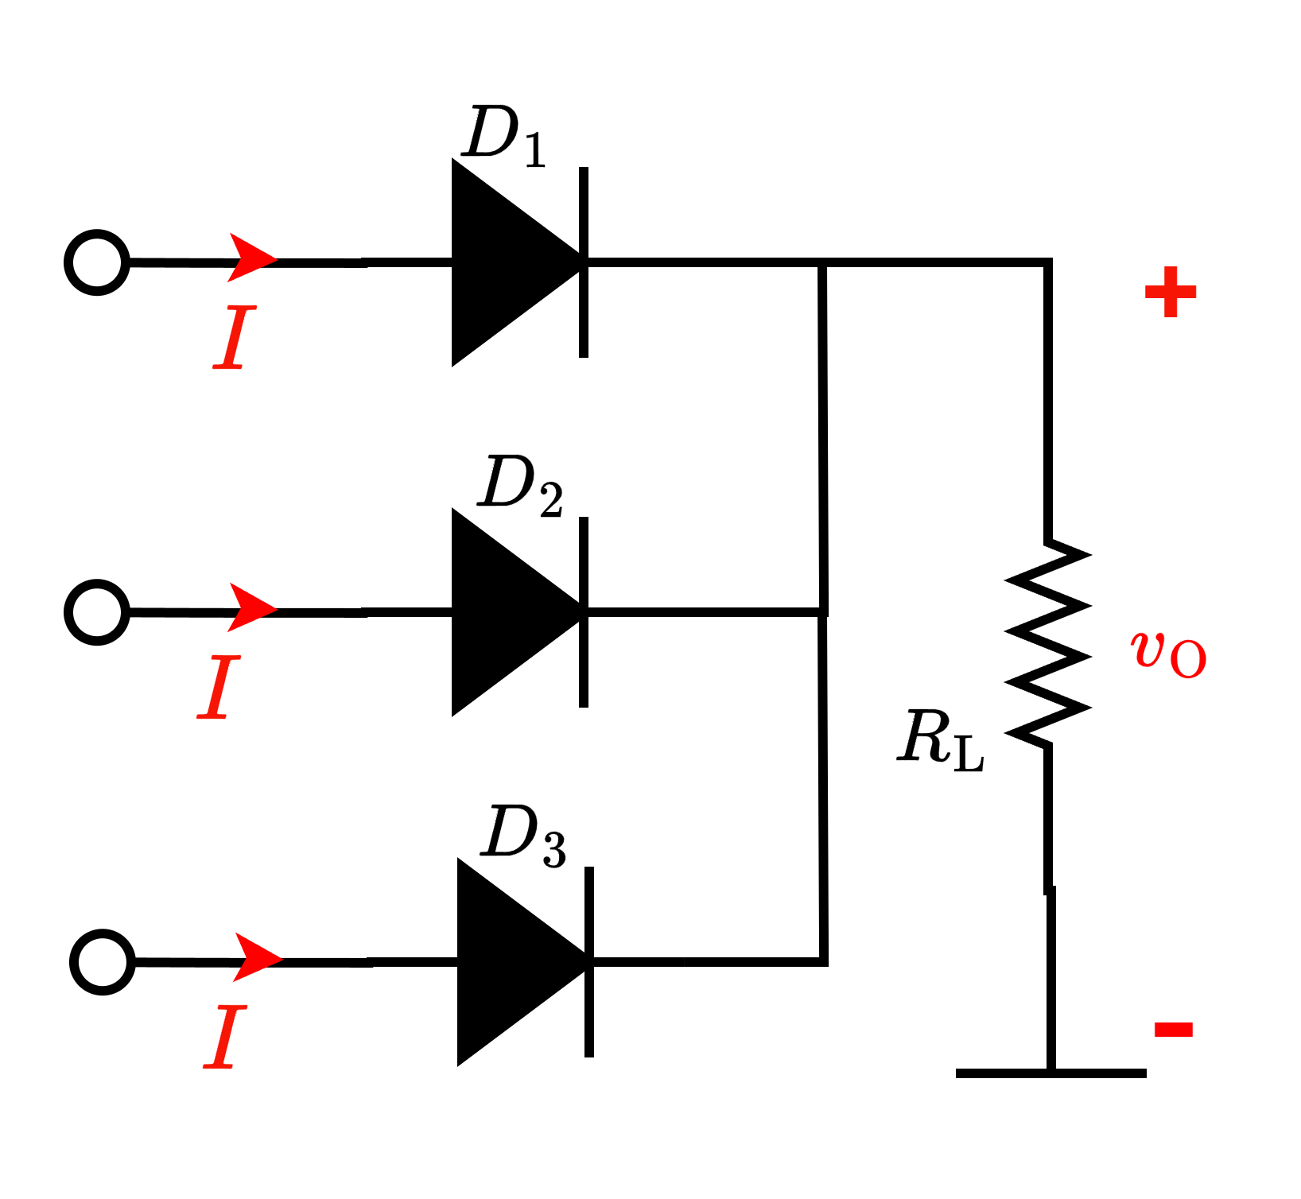
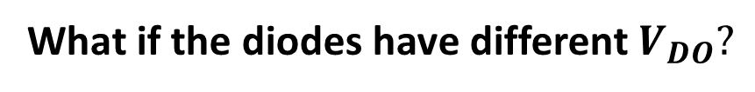

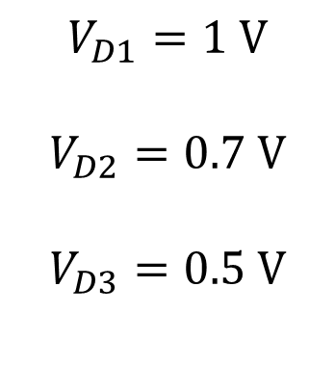
Logical Operations with Diode (OR)
CVD diode
What if the diodes have different $V_{DO}?$
$$+ v_{d} −$$
$$V_{D1}=1 V$$
$$V_{D2}=0.7 V$$
$$V_{D3}=0.5 V$$
5 V
5 V
5 V

Slide 16
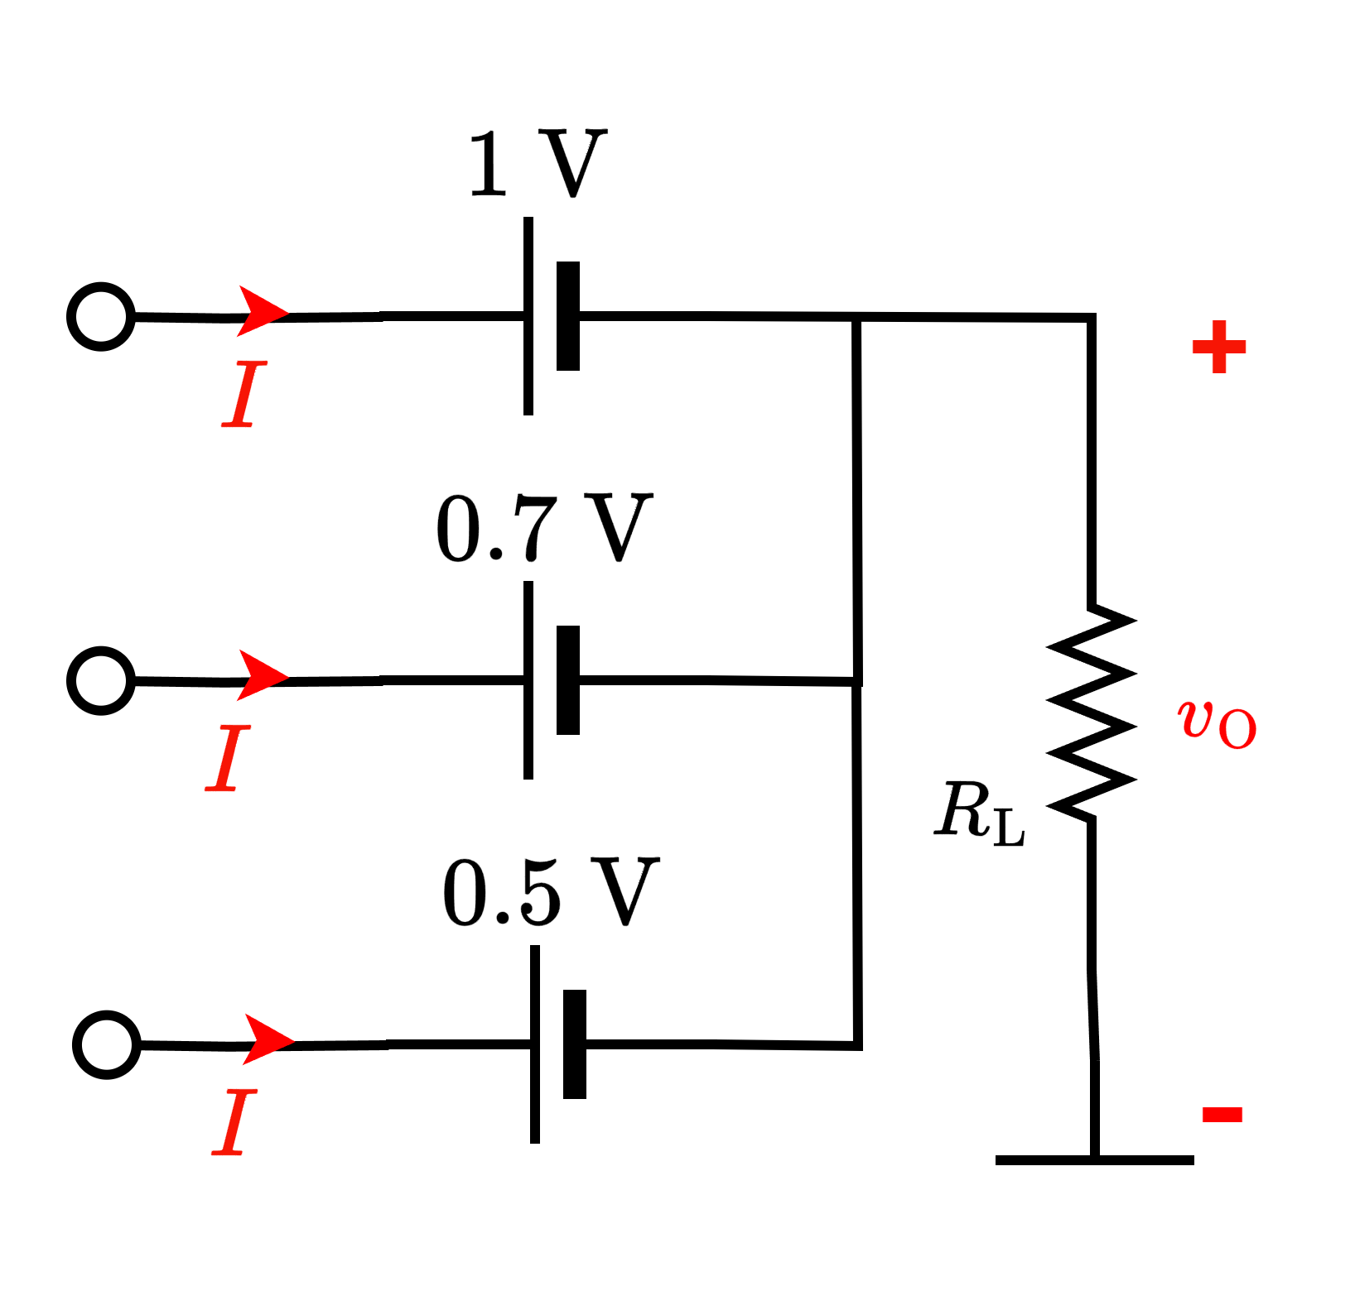

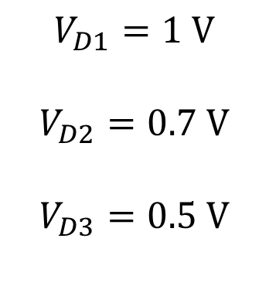




Logical Operations with Diode (OR)
CVD diode
What if two diodes have different $V_{DO}?$
Highest (possible – and consistent)
voltage here!
$$+ v_{d} −$$
$$v_{d}<V_{D1}$$
4.5 V
5 V
$$V_{D1}=1 V$$
$$V_{D2}=0.7 V$$
$$V_{D3}=0.5 V$$
$$v_{d}<V_{D2}$$
5 V
Z = 4.5 V
5 V
$$v_{d}=V_{D3}$$

Slide 17
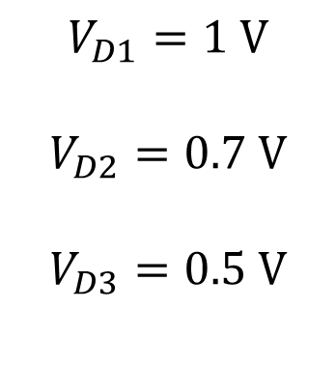
Logical Operations with Diode (OR)
CVD diode
What if the input voltages are different?
$$+ v_{d} −$$
4.2 V
$$V_{D1}=1 V$$
$$V_{D2}=0.7 V$$
$$V_{D3}=0.5 V$$
4 V
3.5 V

Slide 18
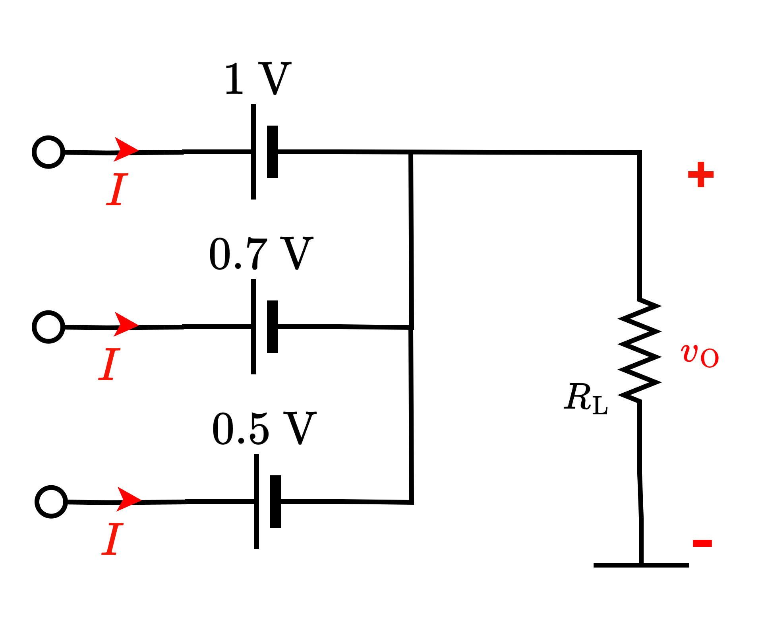
Logical Operations with Diode (OR)
CVD diode
What if the input voltages are different?
Highest (possible – and consistent)
voltage here!
$$+ v_{d} −$$
3.2 V
4.2 V
$$V_{D1}=1 V$$
$$V_{D2}=0.7 V$$
$$V_{D3}=0.5 V$$
3.3 V
4 V
Z = 3.3 V
3.5 V
3 V

Slide 19
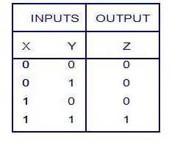
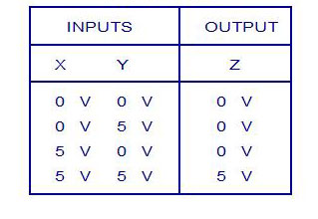
Logical Operations with Diode (AND)
Logic Truth Table
Voltage Truth Table
Low/False High/True
Logic Levels: 0 1
Corresponding voltage levels: 0V 5V

Slide 20
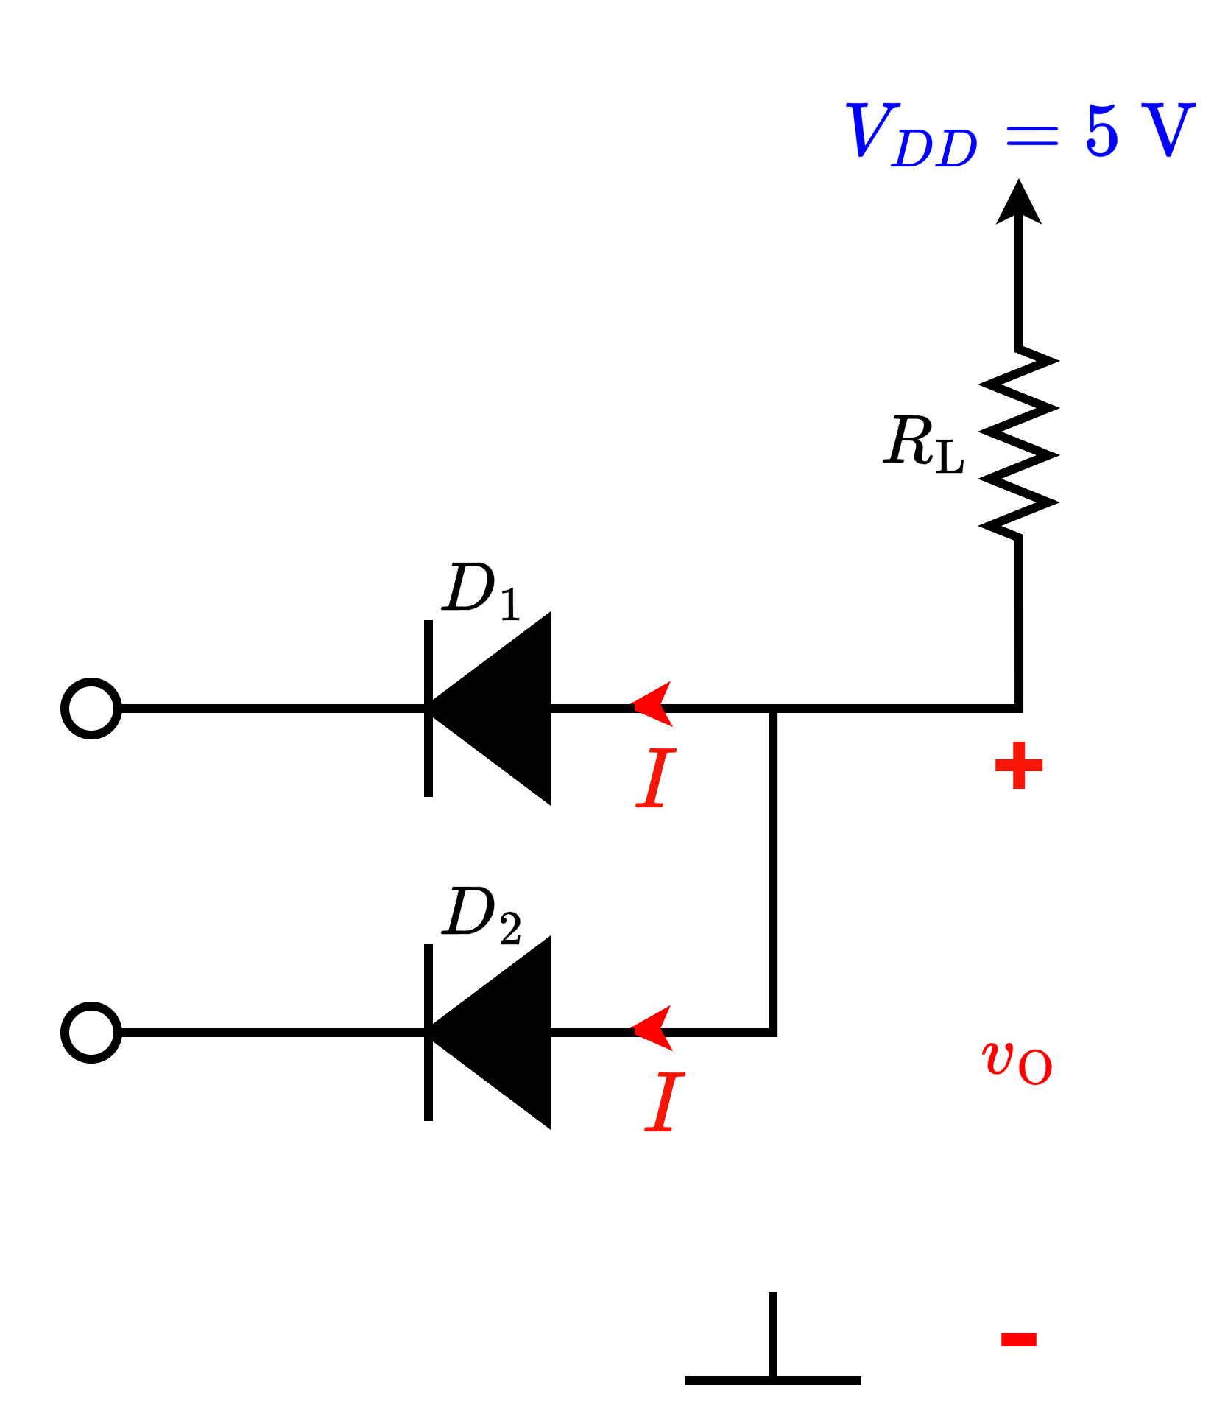
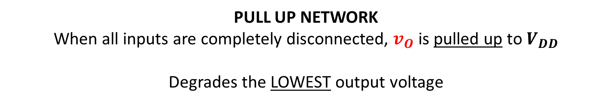
Logical Operations with Diode (AND)
Voltage Truth Table
X
Y
=Z
PULL UP NETWORK
When all inputs are completely disconnected, $v_{O}$ is pulled up to $V_{DD}$
Degrades the LOWEST output voltage

Slide 21
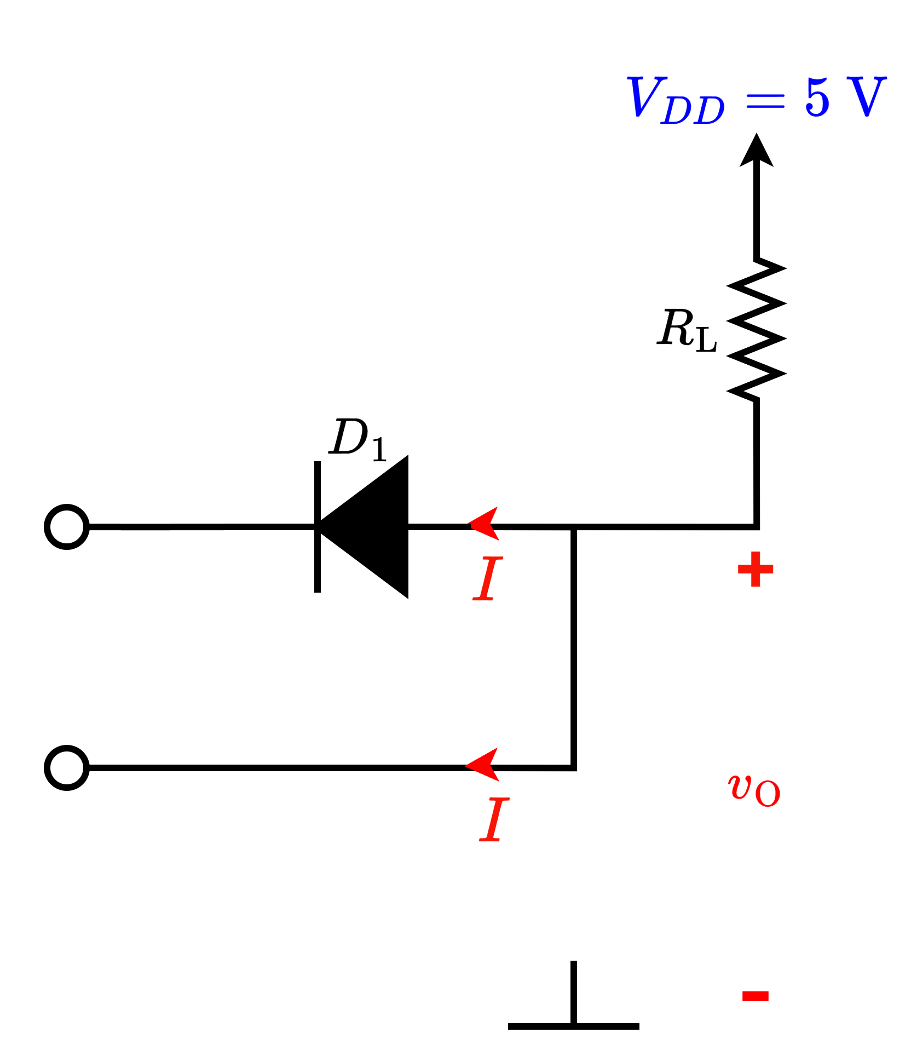
Logical Operations with Diode (AND)
Ideal diode
5 V
0 V
5 V
0 V
0 V
Z = 0 V

Slide 22
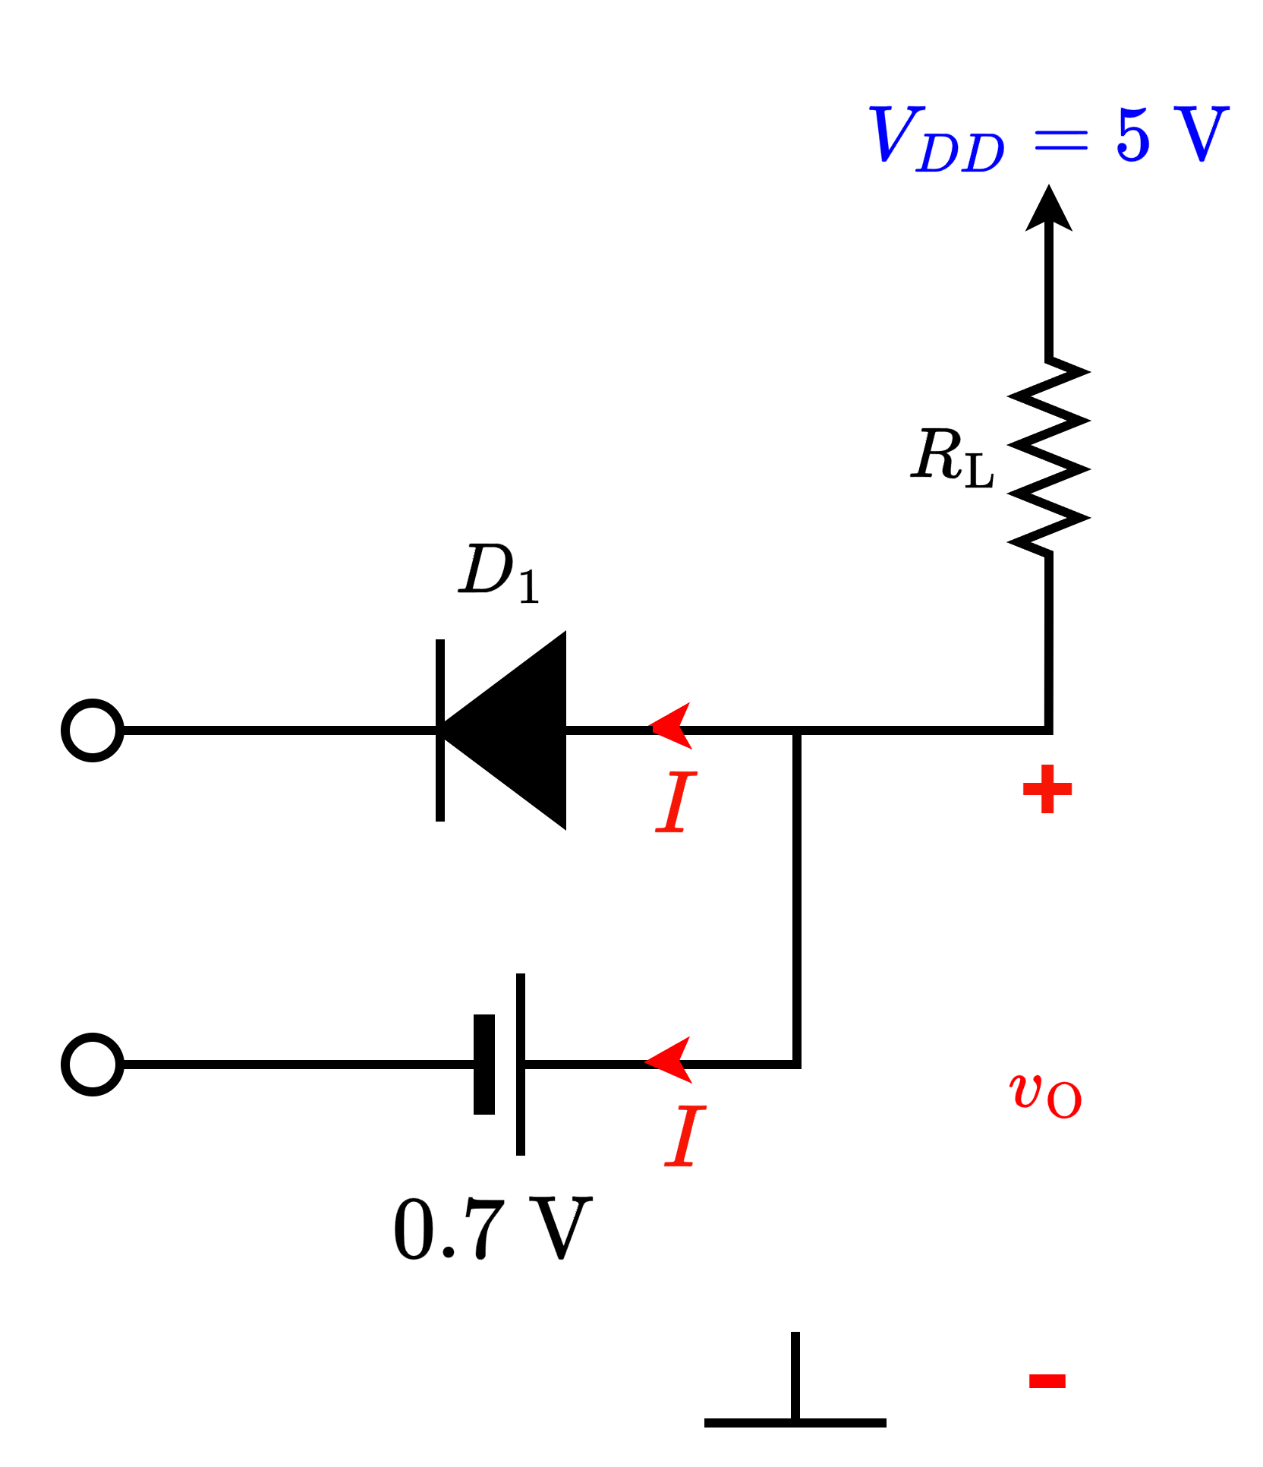
Logical Operations with Diode (AND)
CVD diode
5 V
0.7 V
5 V
0 V
0 V
Z = 0.7 V
Degraded 0 V

Slide 23
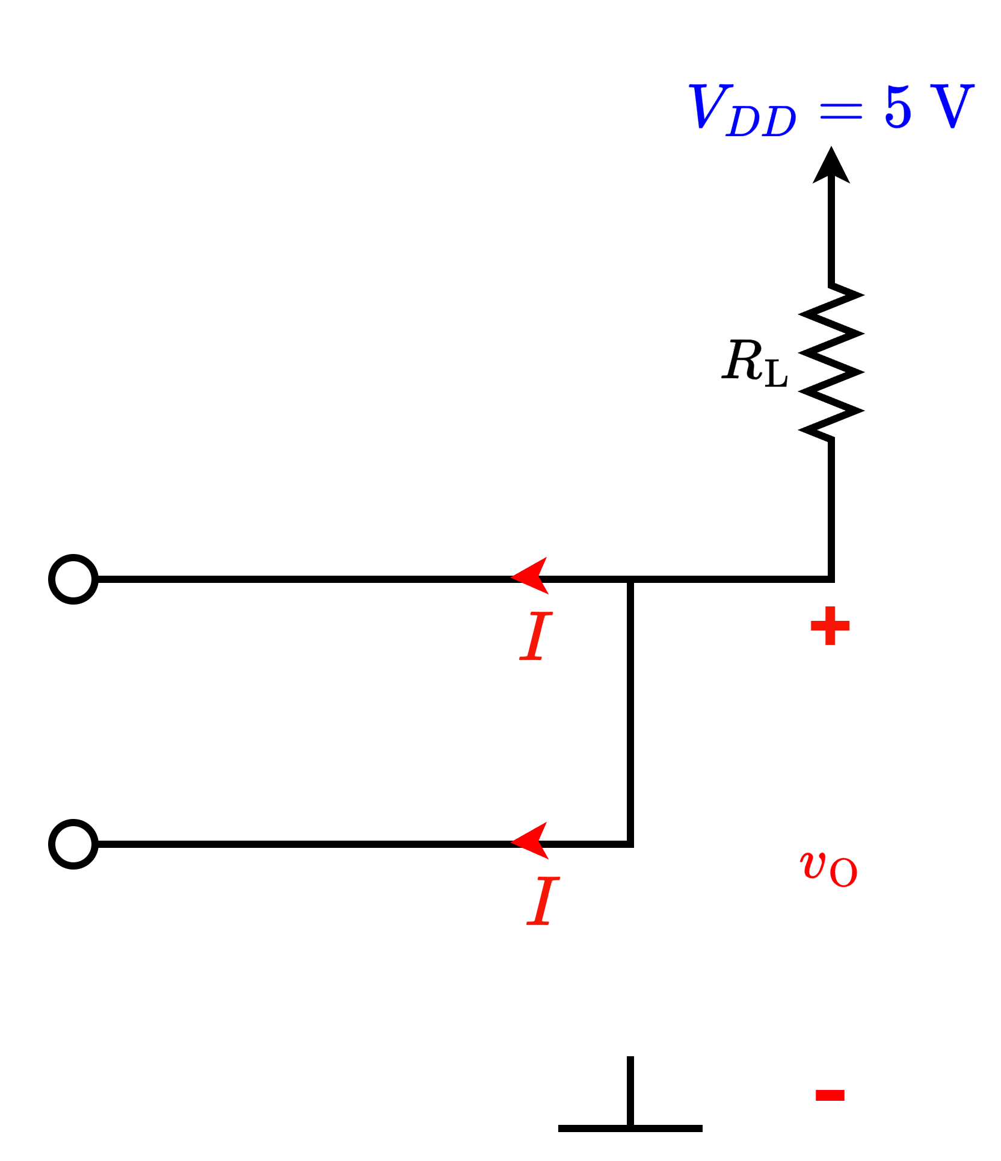


Logical Operations with Diode (AND)
Ideal diode
5 V
$$I=0$$
5 V
5 V
5 V
5 V
$$I=0$$
Z = 5 V

Slide 24

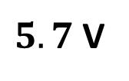
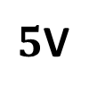
Logical Operations with Diode (AND)
CVD diode
$5.7$V
5 V
$5$V
5 V
5 V
5 V
Z = 5 V

Slide 25



Logical Operations with Diode (AND)
Ideal diode
0 V
$$v_{d}=0$$
0 V
0 V
0 V
0 V
$$v_{d}=0$$
Z = 0 V

Slide 26
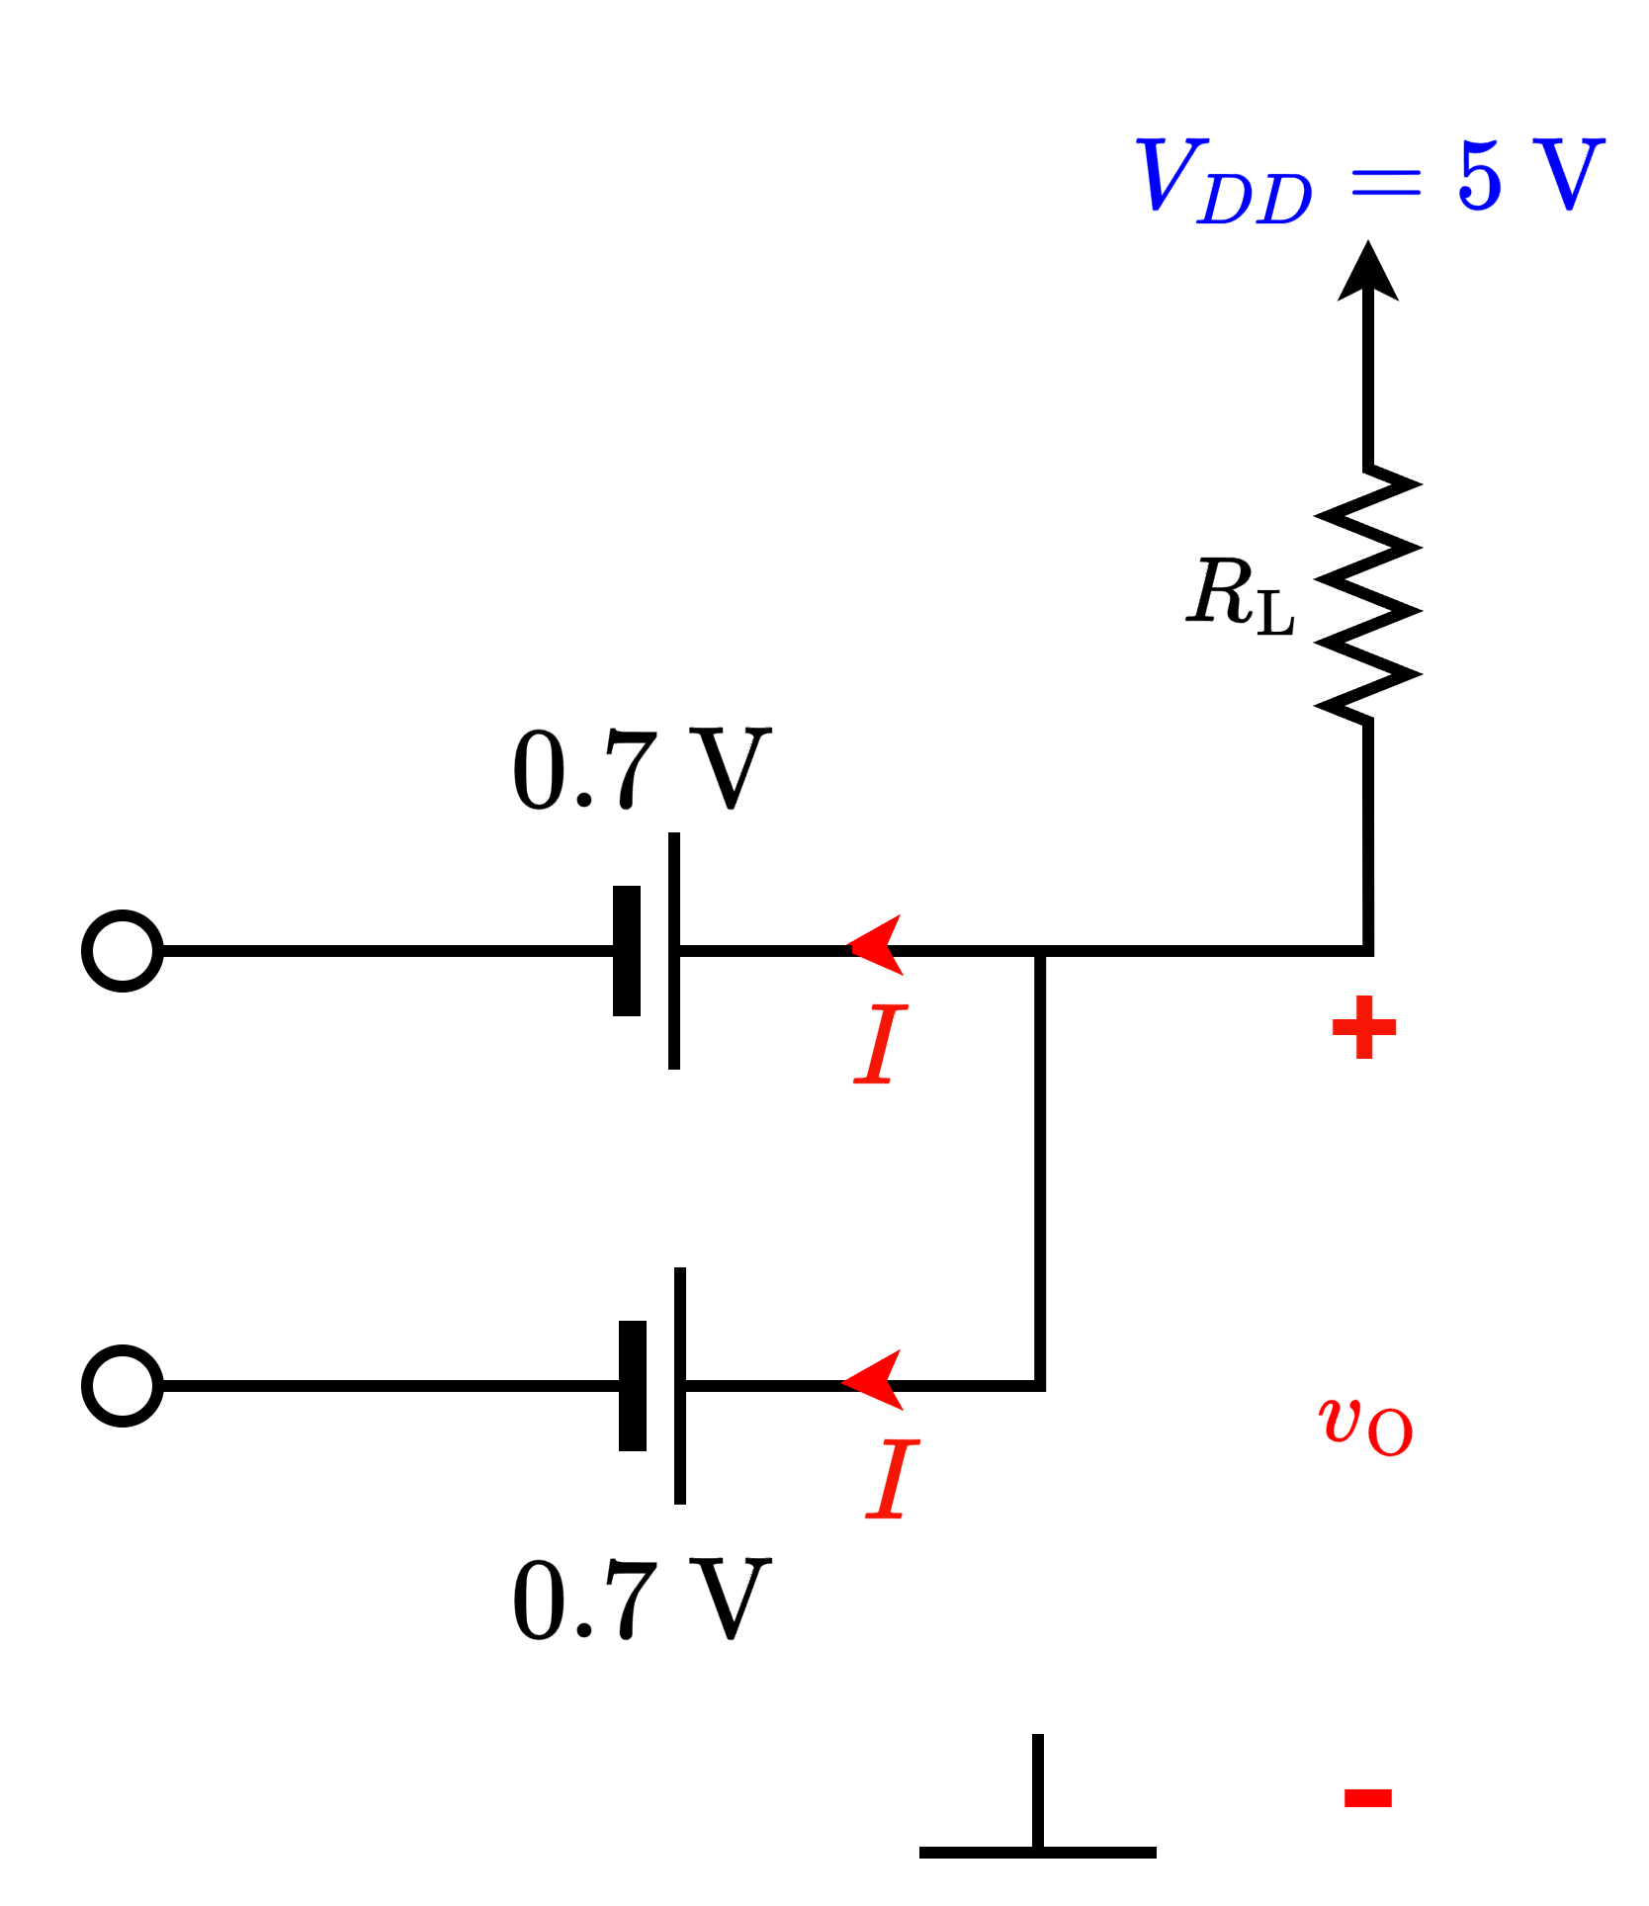
Logical Operations with Diode (AND)
CVD diode
0 V
0 V
0 V
0 V
Z = 0.7 V
Degraded 0 V
Both diodes have same $V_{DO}$

Slide 27
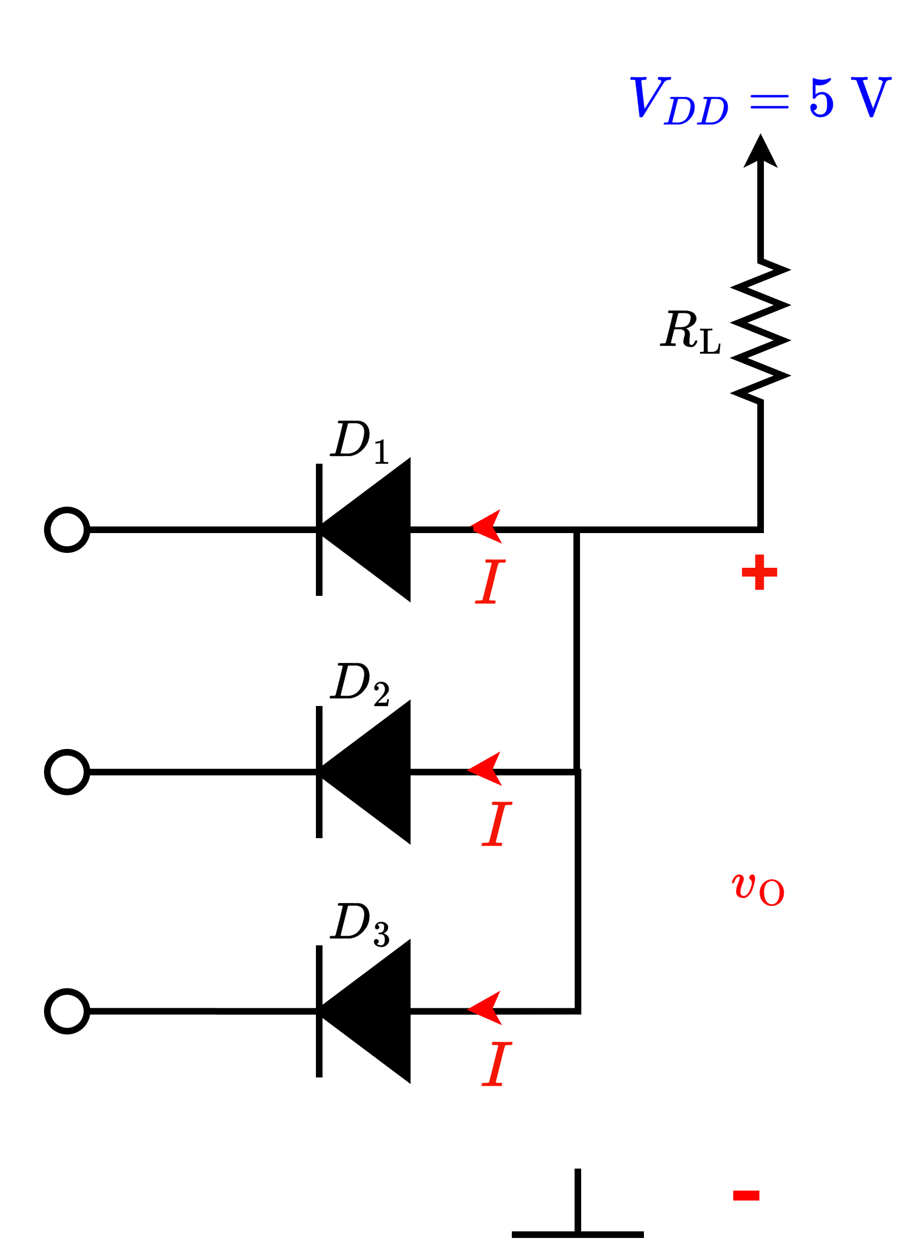

Logical Operations with Diode (AND)
CVD diode
What if the diodes have different $V_{DO}?$
0 V
$$V_{D1}=1 V$$
$$V_{D2}=0.7 V$$
$$V_{D3}=0.5 V$$
0 V
0 V
$$+ v_{d} −$$

Slide 28
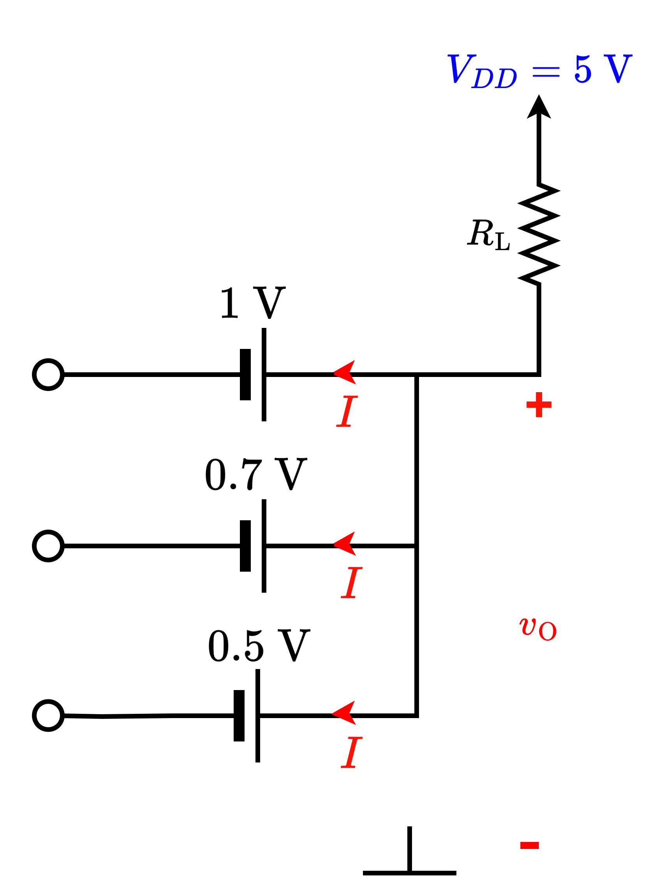

Logical Operations with Diode (AND)
CVD diode
What if the diodes have different $V_{DO}?$
0.5 V
0 V
$$V_{D1}=1 V$$
$$V_{D2}=0.7 V$$
$$V_{D3}=0.5 V$$
0 V
Lowest (possible – and consistent)
voltage here!
0 V
$$+ v_{d} −$$

Slide 29
Part 1 ends here

Slide 30
Outline
Diode Logic Gates – Examples and combined operation

Slide 31
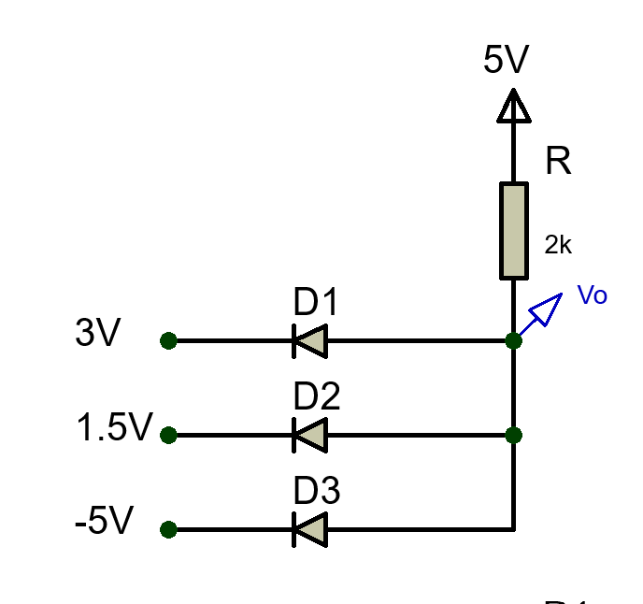

Effect of input Voltage Variation in Logic Gates (AND)
Example 1: Find the value of Vo (All the diodes are ideal diodes)
D1 and D2 are OFF → Open Circuit
Only D3 is ON → Short Circuit
$$V_{O}= −5 V$$
$\text{Current}\text{, }I=\frac{5 V−(−5 V)}{\text{2} \text{k}\text{Ω}}$= 5 mA
Lowest (possible – and consistent)
voltage here!

Slide 32
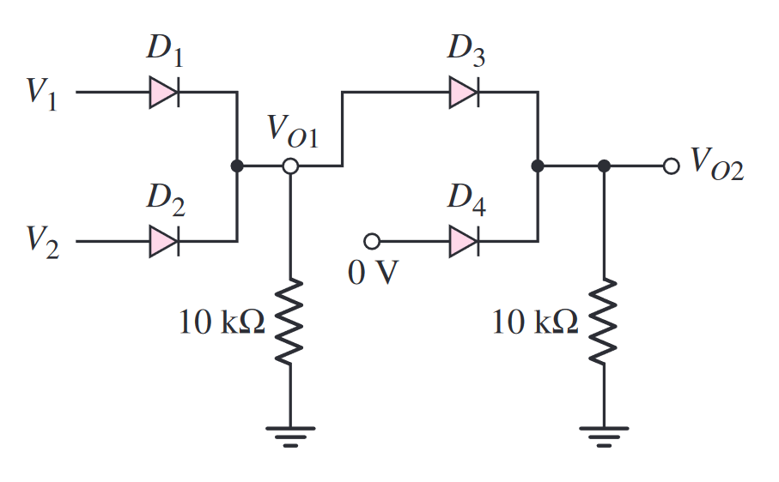
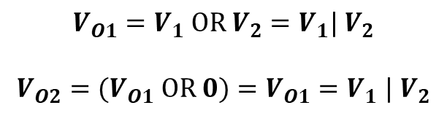
Combined Logic Circuits
$$V_{O1}=V_{1} OR V_{2}=V_{1}| V_{2}$$
$$V_{O2}=(V_{O1} OR 0)=V_{O1}{=V}_{1}| V_{2}$$

Slide 33

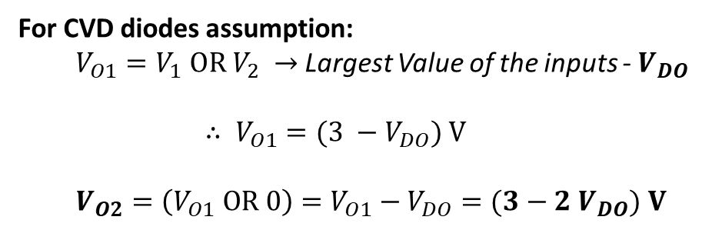
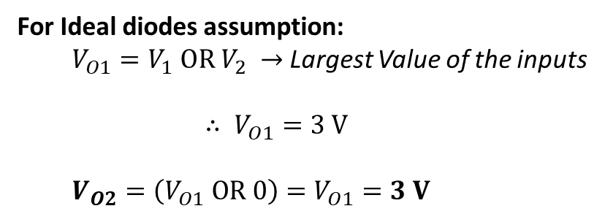
Combined Logic Circuits
Example 2:
Suppose: $V_{1}=3 V$, $V_{2}=2 V$.
For Ideal diodes assumption:
$V_{O1}=V_{1} OR V_{2} →$Largest Value of the inputs
$$∴ V_{O1}=3 V$$
$V_{O2}=\left(V_{O1} OR 0\right)=V_{O1}=3 V$
For CVD diodes assumption:
$V_{O1}=V_{1} OR V_{2} →$Largest Value of the inputs - $V_{DO}$
$$∴ V_{O1}=(3 −V_{DO}) V$$
$V_{O2}=\left(V_{O1} OR 0\right)=V_{O1}−V_{DO}=(3−2 V_{DO}) V$
** In CVD diode models, we are assuming that all diodes have equal drop.

Slide 34
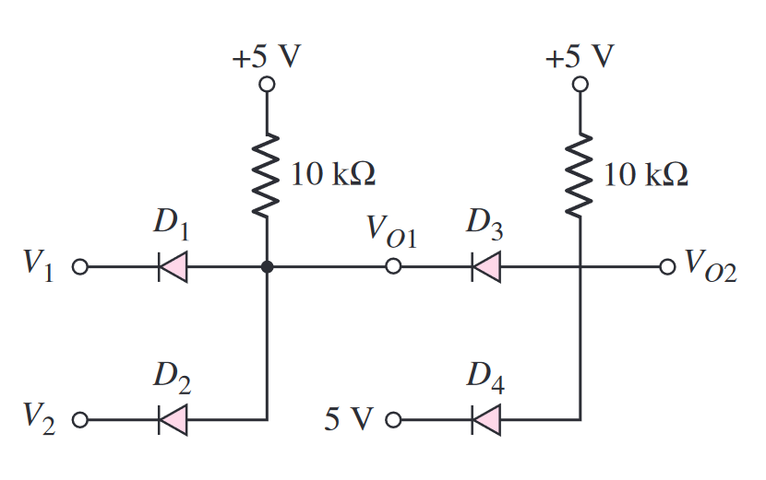
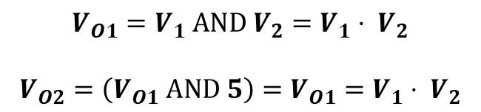
Combined Logic Circuits
$$V_{O1}=V_{1} AND V_{2}=V_{1}⋅ V_{2}$$
$$V_{O2}=\left(V_{O1} AND 5\right)=V_{O1}=V_{1}⋅ V_{2}$$

Slide 35

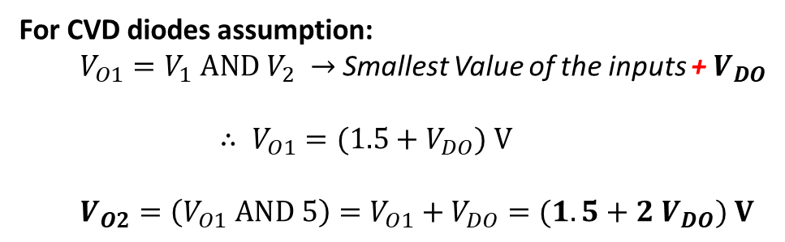
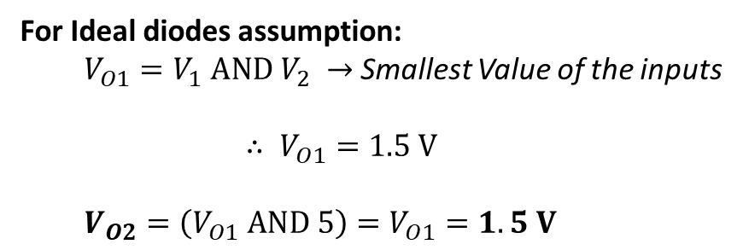
Combined Logic Circuits
Example 3:
Suppose: $V_{1}=3 V$, $V_{2}=1.5 V$.
For Ideal diodes assumption:
$V_{O1}=V_{1} AND V_{2} →$Smallest Value of the inputs
$$∴ V_{O1}=1.5 V$$
$V_{O2}=\left(V_{O1} AND 5\right)=V_{O1}=1.5 V$
For CVD diodes assumption:
$V_{O1}=V_{1} AND V_{2} →$ Smallest Value of the inputs + $V_{DO}$
$$∴ V_{O1}=(1.5+V_{DO}) V$$
$V_{O2}=\left(V_{O1} AND 5\right)=V_{O1}+V_{DO}=(1.5+2 V_{DO}) V$
** In CVD diode models, we are assuming that all diodes have equal drop.

Slide 36












Combined Logic Circuits
Example 4:
Express $V_{O}$ as a Boolean expression of $V_{1}, V_{2}, V_{3}$ and $V_{4}$
$$D_{1}$$
$$V_{5}$$
$$D_{5}$$
$$D_{2}$$
$$V_{O}=\left(V_{1}⋅V_{2}\right)|(V_{3}⋅V_{4})$$
$$V_{O}=\left(V_{1}AND V_{2}\right) OR (V_{3} AND V_{4})$$
$$D_{6}$$
$$D_{3}$$
$$V_{6}$$
$$D_{4}$$

Slide 37
Part 2 ends here

Slide 38
Outline
Op-Amp + Diodes
Exponential Converter
Logarithmic Converter
Multiplier
Divider
Hybrid Problems

Slide 39


Real diode
Relation between diode current and diode voltage:
I-V characteristics of a real diode
η is called the ideality factor (try to recall, you measured this in the lab!)

Slide 40


Exponential (Anti-log) Converter
$$I_{f}=I_{S}\exp\left(\frac{V_{i}−0}{V_{T}}\right)$$
$$\frac{0−V_{O}}{R_{f}}=I_{S}exp⁡(\frac{V_{i}}{V_{T}})$$
$$V_{O}=I_{s}R_{f}⋅exp⁡(\frac{V_{i}}{V_{T}})$$

Slide 41


Logarithmic Amplifier
$$I_{f}=I_{S}\exp\left(−\frac{V_{O}}{V_{T}}\right)$$
$$\frac{V_{i}}{R_{1}}=I_{S}exp⁡(−\frac{V_{O}}{V_{T}})$$
$$\frac{V_{i}}{I_{s}R_{1}}=exp⁡(−\frac{V_{O}}{V_{T}})$$
$$V_{O}=−V_{T}⋅ln\left(\frac{V_{i}}{I_{S}R_{1}}\right)$$

Slide 42



































APPLICATIONS:
Implementing operational functions
$f=−\frac{1}{3}∫x⋅dt+2 ln y+4z$

Slide 43
















APPLICATIONS:
Implementing operational functions
$f=−3\frac{dx}{dt}+2\exp\left(y\right)+4z$

Slide 44





















Multiplier
$$f=xy$$
$$\ln{(f)}=\ln\left(xy\right)=\ln\left(x\right)+\ln\left(y\right)$$
$$f=\exp\left(\ln\left(x\right)+\ln\left(y\right)\right)$$
So,
$f=\exp\left(z\right)$ where $z=\ln\left(x\right)+\ln\left(y\right)$

Slide 45
















Divider
$$f=xy/z$$
$$\ln{(f)}=\ln\left(xy/z\right)=\ln\left(x\right)+\ln\left(y\right)−\ln\left(z\right)$$
$$f=\exp\left(\ln\left(x\right)+\ln\left(y\right)−\ln\left(z\right)\right)$$
So,
$f=\exp\left(z\right)$ where $z=\ln\left(x\right)+\ln\left(y\right)−\ln\left(z\right)$

Slide 46

Hybrid Problems
Example 1:

Slide 47

Hybrid Problems
Example 2:

Slide 48
Thank You!

